Slide 1
Project Title Loan Approval Estimation Deploying Deep Learning and Blockchain Technologies
Team Details
Sai Vishwanth(20EG105101)
Jaya Sravani(20EG105119)
Manikanta(20EG105156)
Chandana(20EG105160)
Project Supervisor
Dr. G Bala Krishna
Assistant Professor

Slide 2
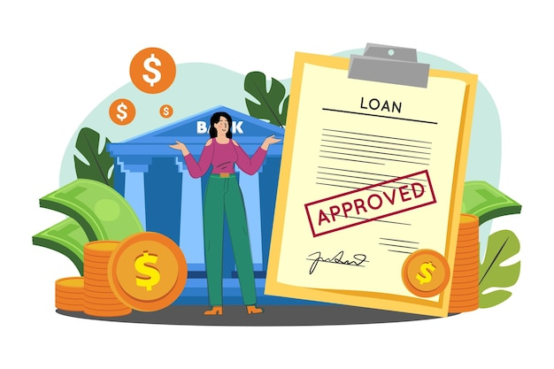
Introduction
In the contemporary banking sector, there is a pressing demand for rapid advancements as technology strives to meet the industry's evolving needs.
With a surge in loan applications, there is a critical emphasis on swift, accurate, and reliable loan approval models that effectively assess risks.
It must also ensure that the data is secure and transparent processes with tamper-proof for integrity.

Slide 3










Concept Tree
Can the customer pay back?
Is it profitable to bank?
Approval
Customer needs loan
Bank

Slide 4
Problem Statement
The current banking industry faces significant challenges when it comes to the loan approval process. Due to long wait times, security risks, and reliance on old systems, which slow down the loan process.
Current methods, though developed, aren't fully connected from start to finish. This calls for a thorough approach to create a smooth and strong solution.
To address these limitations, we propose a solution that combines Deep Learning and Blockchain to enhance loan approval security and provide faster processing times.

Slide 5
Problem Illustration
OBJECTIVES:
Develop a model for loan approval prediction.
Implement a data storage system to enhance transparency and guarantee the tamper-proof integrity of the data.
Create a user-friendly interface for seamless interaction and accessibility.

Slide 6
Proposed Method for Deep Learning model
Deep learning model:
Data collection: Kaggle dataset
Preprocessing :
- Imputation: replace the null values with a mean of the column.
- Handling outlies: IQR method
- Transfer categorical to ordinal data
- Convert required columns to integer datatype
- Normalization of data
Split into train and test dataset
Utilize the sequential neural network architecture with 4 hidden layers for the activation function of ReLU with neurons 128, 256,256, and 256 respectively, linear activation for output.
Train the model on train data sets uprising historical known data including approved and denied cases.

Slide 7
Flow of Deep learning model
Handling Outliers
Transfer categorical to ordinal data
Converting required columns to integer datatype
Data Collection
Imputation
Pre-processing
Normalization of data
Deep learning model
Sequential neural network with ReLU activation
Convert into pickle file
Train the model
Split train and test data
Correlation matrix

Slide 8
Connecting the DL model and Blockchain
Application:
The converted pickle file is deployed in Flask web framework
The Frontend is connected to the Flask and predicted output is reflected on frontend
Construct and deploy a smart contract for data storage
Using the ether.js library we can connect to the blockchain environment
When a user clicks on “save data” it connects to MetaMask and requests to implement a smart contract function
Once the request is approved the information is successfully stored on the blockchain
Currently the application is run on the Seploia test network.

Slide 9

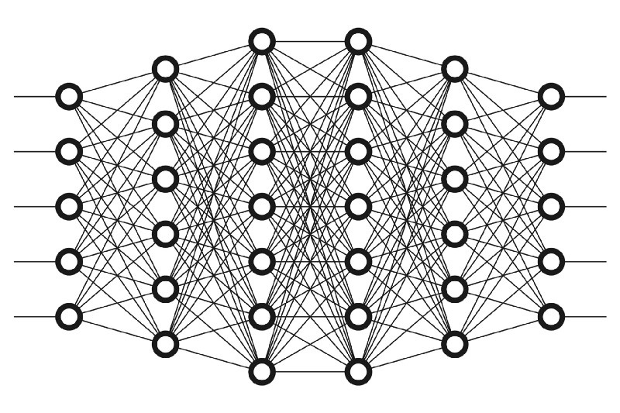










Proposed Architecture
Frontend
Backend
Deep Learning Model
Input
Predict
Converted into
Prediction
model.pkl
User
Save Data
Data Stored

Slide 10
UML Diagrams

Slide 11
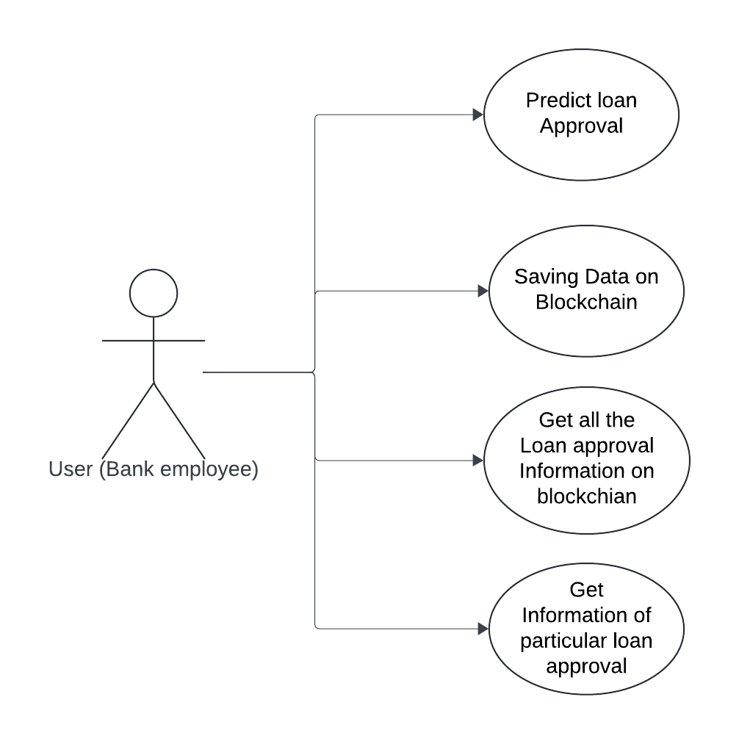
Use Case Diagram

Slide 12
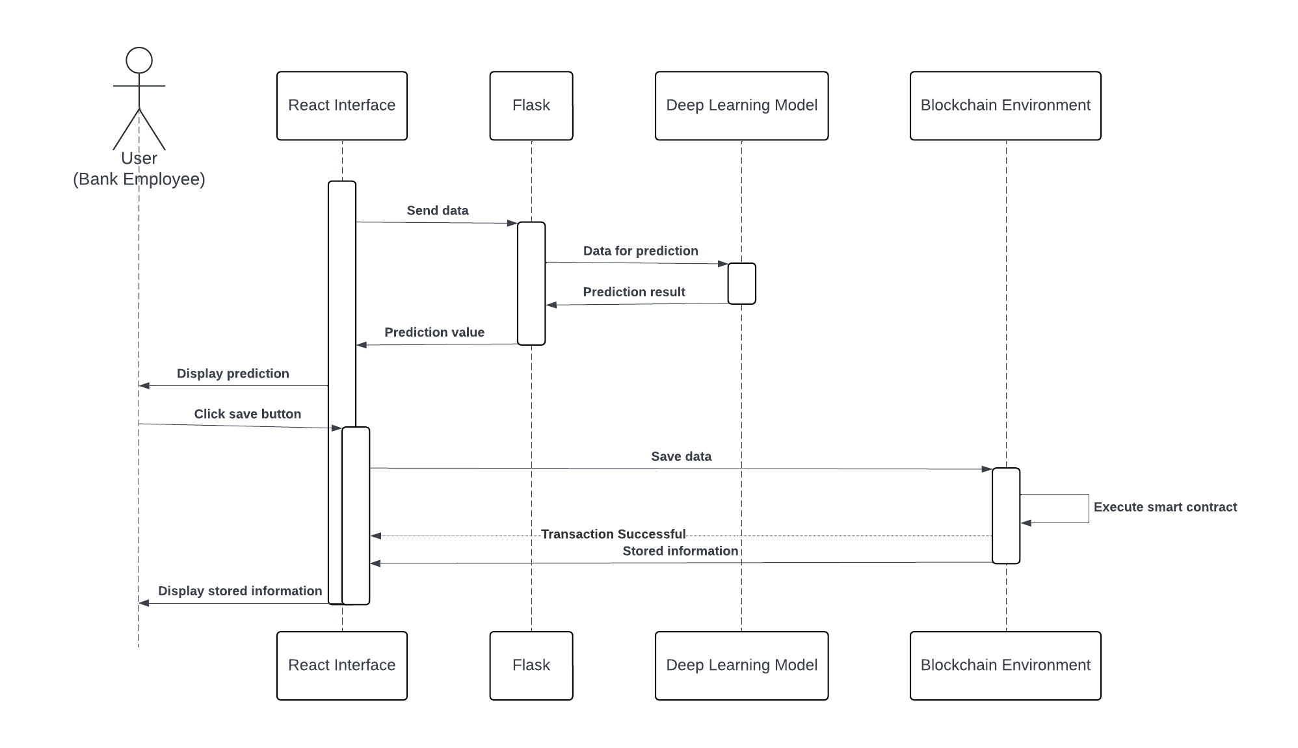
Sequence Diagram

Slide 13
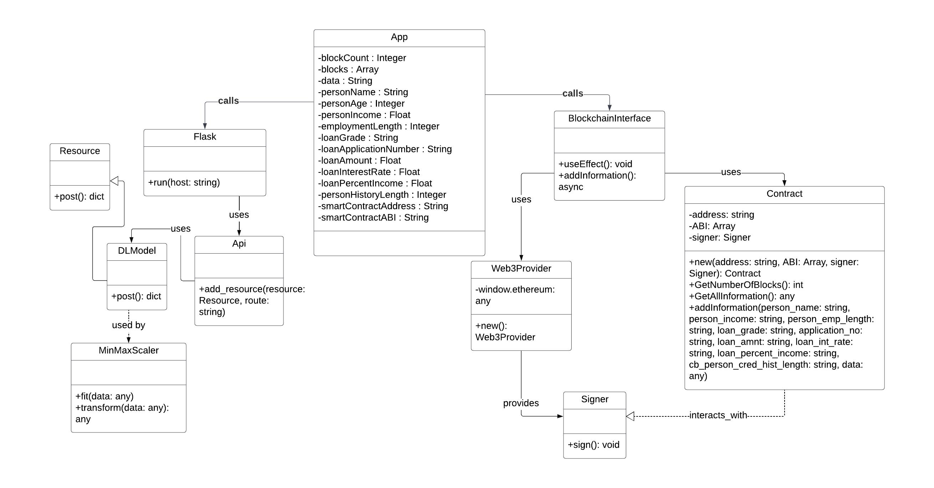
Class Diagram

Slide 14
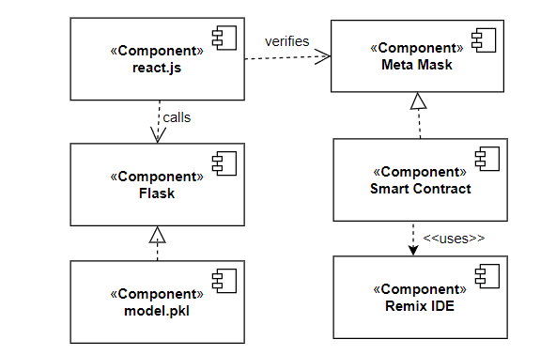
Component Diagram

Slide 15
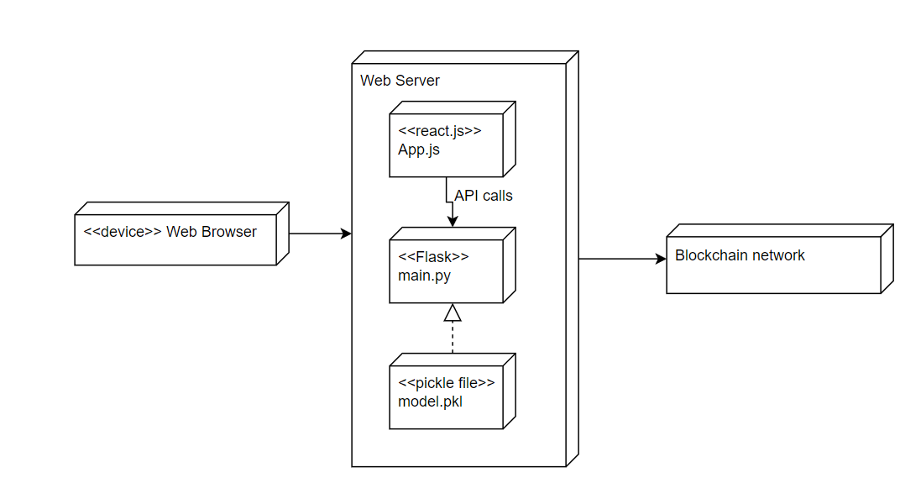
Deployment Diagram

Slide 16
Experiment Environment
Deep Learning Model:
Dataset : Kaggle dataset (credit_risk_dataset)
Libraries: NumPy, Pandas, MatplotLib, ScikitLearn, TensorFlow, pickle
Application:
Text Editors/IDEs: Visual Studio Code, RemixIDE
Package Managers: npm (Node Package Manager), pip (Python Package Installer)
Web Extensions: MetaMask
Frontend Libraries and Frameworks: React.js, Ethers.js
Backend Frameworks: Flask
Development Language: JavaScript, Python, Solidity
Testnet: Sepolia Testnet

Slide 17
Experiments on selecting Deep Learning Model

Slide 18
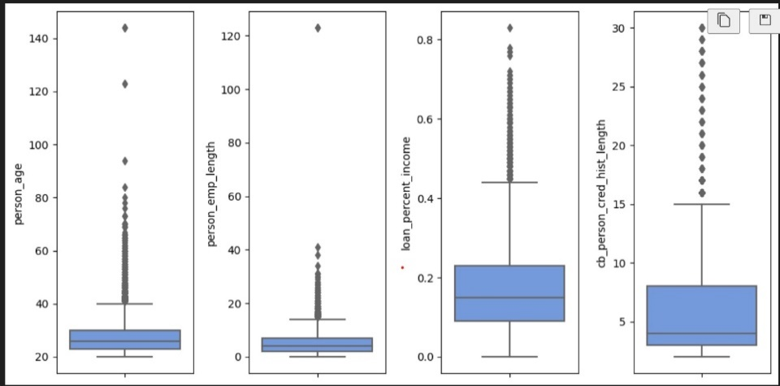
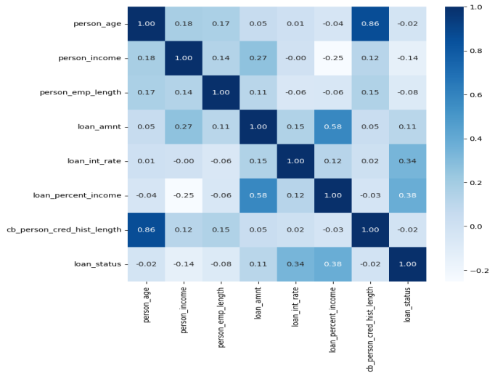
Feature Analysis
Analysis of Outliners
correlation matrix

Slide 19

Final Feature selection
Columns in dataset
Final columns selected
person_age | person_income
person_home_ownership | person_emp_length
loan_intent | loan_grade
loan_percent_income | loan_int_rate
loan_status | loan_amnt
cb_person_default_on_file | cb_person_cred_hist_length
person_age | person_income
loan_grade | person_emp_length
loan_percent_income | loan_int_rate
cb_person_cred_hist_length | loan_amnt

Slide 20
Model Selection Experiment
A Sequential neural network model was selected for credit risk prediction due to its capacity to capture complex relationships within the data.
Experiment with change in neuron layers
Experiment with changing Epoches
Number of Layers | Number of neurons in each layer | Accuracy
2 layers | 256,256 | 0.8500
3 layers | 128, 256, 256 | 0.8519
3 layers | 265, 256, 256 | 0.8500
4 layers | 128, 265, 256, 256 | 0.8553
4 layers | 256, 256, 256, 256 | 0.8533
5 layers | 128, 256,256,256,256 | 0.8499
Number of Epoches | 50 | 100 | 200
Accuracy | 0.8557 | 0.8495 | 0.8460
Precision | 0.6757 | 0.6675 | 0.6512
F1 | 0.6012 | 0.5637 | 0.5736
recall | 0.6363 | 0.6112 | 0.6099

Slide 21
Model Selection Experiment
Experiment with changing learning rate and epoches
Learning rate | Epoch=50 | Epoch=100
0.1 | 0.8551 | 0.8519
0.01 | 0.8515 | 0.8537
0.001 | 0.8539 | 0.8499
Experiment using different optimizers
Optimizers | Accuracy
Stochastic Gradient Descent (SGD) | 0.7901
Adams: (Adaptive Moment Estimation) | 0.8550
RMSprop (Root Mean Square Propagation) | 0.8501
Adagrad (Adaptive Gradient Algorithm) | 0.7901
Nadam | 0.7901

Slide 22

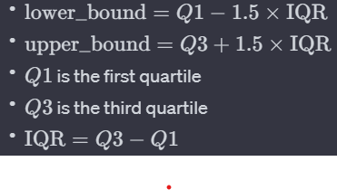
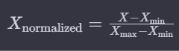
Mathematical formulas used in pre-processing
Mean:
i​
Inter Quartile Range:
Normalisation:

Slide 23
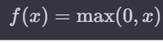


Mathematical formulas used in Deep Learning model
ReLU:
i​
Linear:
Mean Absolute Error:

Slide 24
Experiment Results

Slide 25
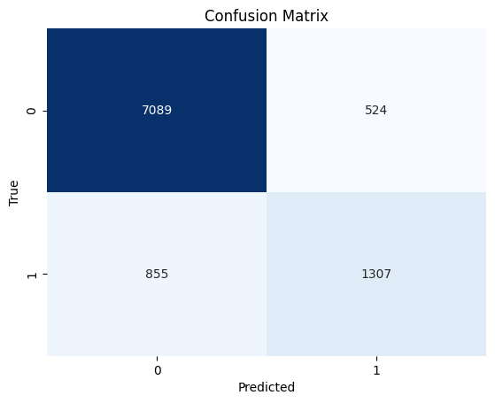
Model Evaluation
Performance Matrix:
Accuracy - 0.8592387126649688
Precision - 0.713480102695763
Recall -0.6042895752895753
F1 score -0.654 80747552655

Slide 26
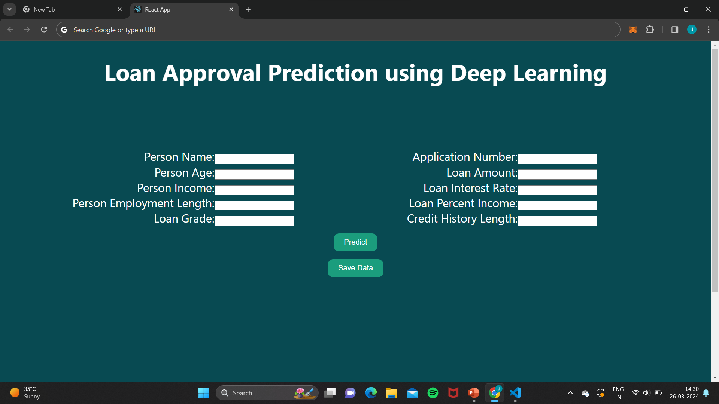
Experiment Screen shorts

Slide 27
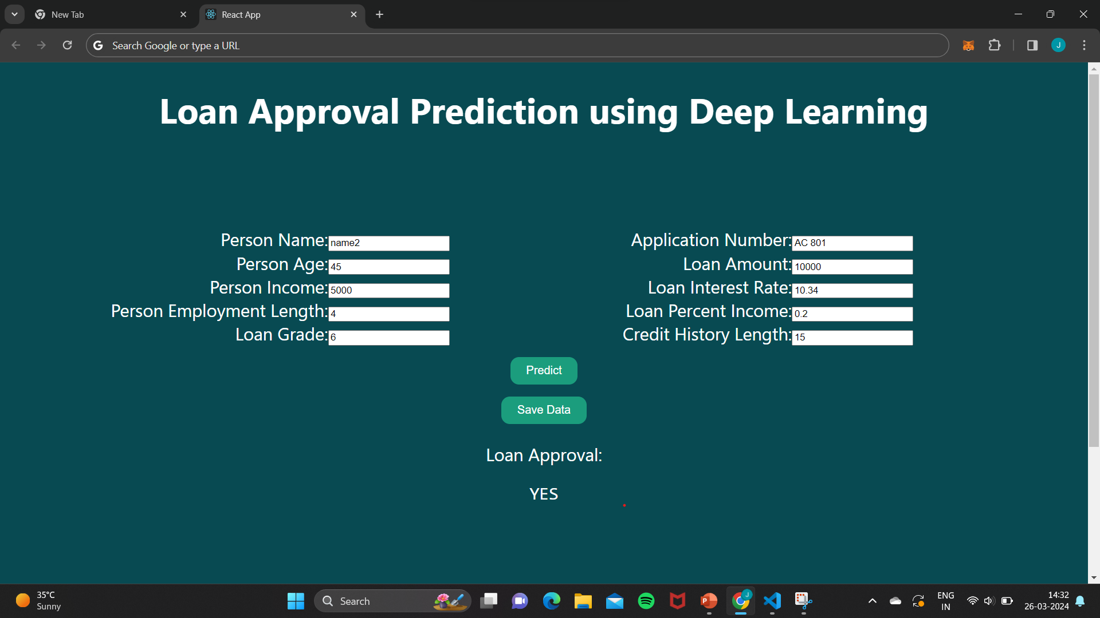
Experiment Screen shorts

Slide 28
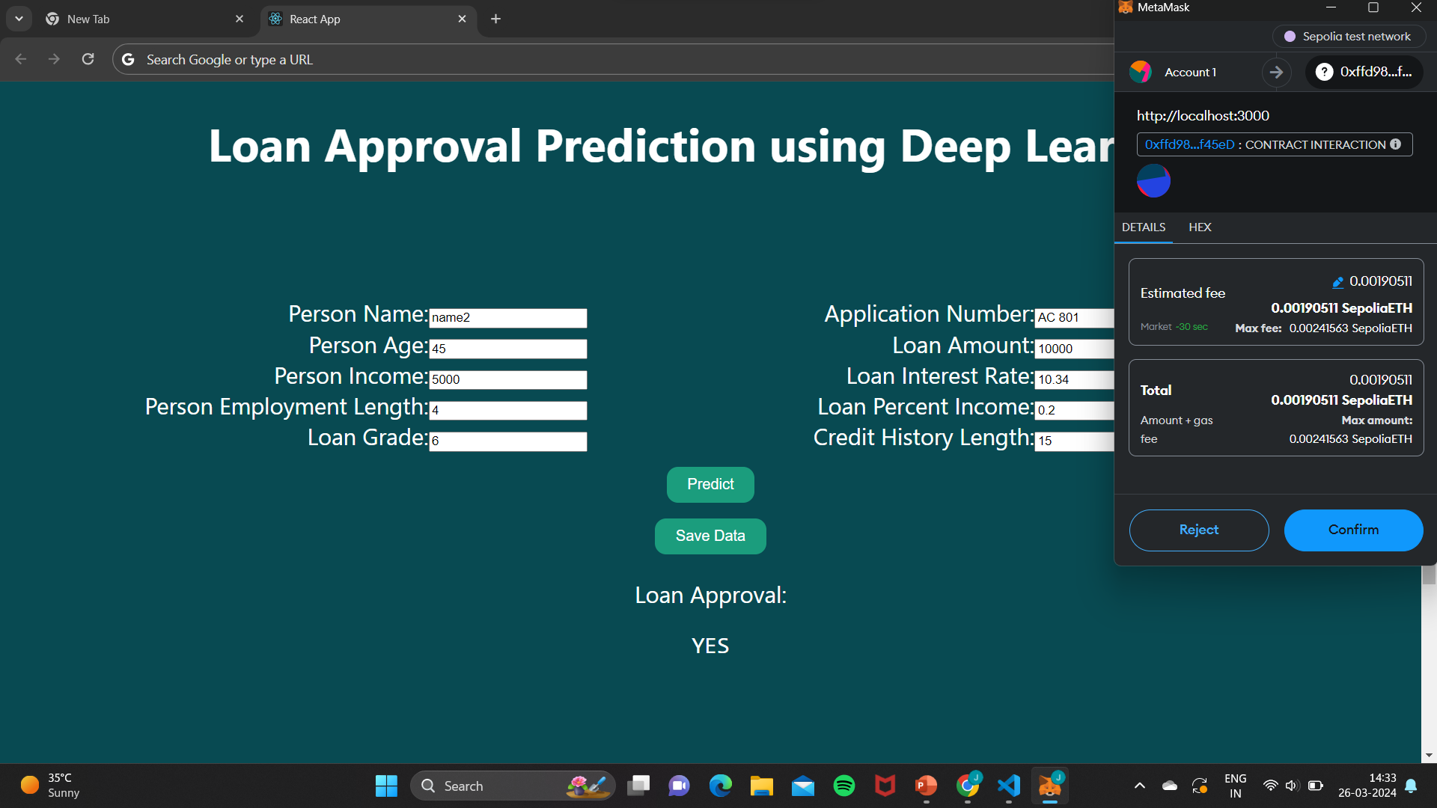
Experiment Screen shorts

Slide 29
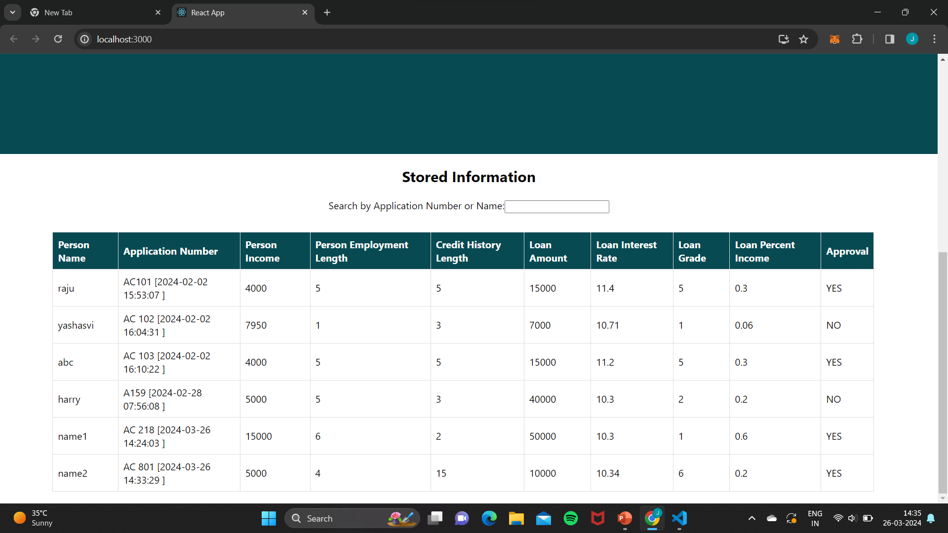

Experiment Screen shorts

Slide 30
Justification
Characteristics achieved by our application
Accuracy
With an accuracy of 86%, the model shows a significant improvement in predicting loan approval compared to traditional methods.
Transparency
Incorporating blockchain technology ensures tamper-proof storage of outputs, enhancing transparency and trust in the decision-making process.
Efficiency
The end-to-end user-friendly website streamlines the loan approval process, making it more efficient and accessible to users.

Slide 31
Justification
Where the parameter values improved?
Data Preprocessing: Utilizing methods like mean calculation, IQR, and normalization ensures that the input data is appropriately scaled and processed, reducing noise and improving model performance.
Activation Functions: ReLU and linear activation functions help introduce non-linearity and capture complex patterns in the data, leading to improved model accuracy.
Evaluation Metric: Using mean absolute error as an evaluation metric allows the model to minimize prediction errors effectively, resulting in better generalization and higher accuracy.
Blockchain Integration: By leveraging blockchain technology for tamper-proof storage, the model's outputs are securely stored and immutable, enhancing trust and transparency in decision-making.

Slide 32
Thank you

